Slide 1

Categories of algorithms
Sorting algorithms
Search algorithms
Graph algorithms
Path-finding in AI algorithms
Network Flow algorithms
Computational Geometry
Algorithms: Theory, Design and Implementation
Algorithms
F O U R T H E D I T I O N

Slide 2
Algorithms
Algorithms
GRAPHS
Definitions
Graph representation
Depth-first, Breadth-first search algorithms
Single source shortest path
All pairs shortest path (Dijkstra’s algorithm)
Minimum spanning tree algorithms
(kruskal and Prim algorithms)
F O U R T H E D I T I O N

Slide 3
Definitions
G = (V,E)
V is the vertex set.
Vertices are also called nodes and points.
E is the edge set.
Each edge connects two different vertices.
Edges are also called arcs and lines.
Directed edge has an orientation (u,v).
u
v

Slide 4
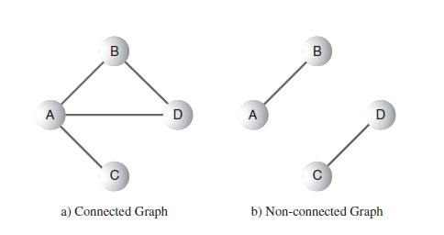
Connected vs. Non-connected Graphs

Slide 5
Directed vs. Undirected Graphs
Undirected edge has no orientation (u,v).
u
v
Undirected graph => no oriented edge.
Directed graph => every edge has an orientation.

Slide 6
Undirected Graph
2
3
8
1
10
4
5
9
11
6
7

Slide 7
Directed Graph (Digraph)
2
3
8
1
10
4
5
9
11
6
7

Slide 8
Street Map A hybrid (un)directed graph
2
3
8
1
10
4
5
9
11
6
7
Some streets are one way.

Slide 9
Vertex Degree
2
3
8
1
10
4
5
9
11
6
7
Number of edges incident to vertex.
degree(2) = 2, degree(5) = 3, degree(3) = 1

Slide 10
Sum of Vertex Degrees
8
10
9
11
Sum of degrees = 2e (e is number of edges)

Slide 11
In-Degree of a Vertex
2
3
8
1
10
4
5
9
11
6
7
In-Degree is number of incoming edges
In-Degree(2) = 1, In-Degree(8) = 0

Slide 12
Out-Degree of a Vertex
2
3
8
1
10
4
5
9
11
6
7
Out-Degree is number of outbound edges
Out-Degree(2) = 1, Out-Degree(8) = 2

Slide 13
Sum of In- and Out-Degrees
each edge contributes 1 to the in-degree of some vertex and 1 to the out-degree of some other vertex
sum of in-degrees = sum of out-degrees = e,
where e is the number of edges in the digraph

Slide 14
Some important graphs:
A planar graph - vertices and edges can be drawn in a plane such that no two of the edges intersect
A cycle graph - length n ≥ 3, vertices can be named v₁, ..., v_{n} so that the edges are v_{i−1}v_{i} for each i = 2,...,n in addition to v_{n}v₁
A bipartite graph - the vertex set can be partitioned into two sets, W and X, so that no two vertices in W are adjacent and no two vertices in X are adjacent
A tree graph

Slide 15
Algorithms
Algorithms
GRAPHS
Definitions
Graph representation
Depth-first, Breadth-first search algorithms
Single source shortest path
All pairs shortest path (Dijkstra’s algorithm)
Minimum spanning tree algorithms
(kruskal and Prim algorithms)
F O U R T H E D I T I O N

Slide 16
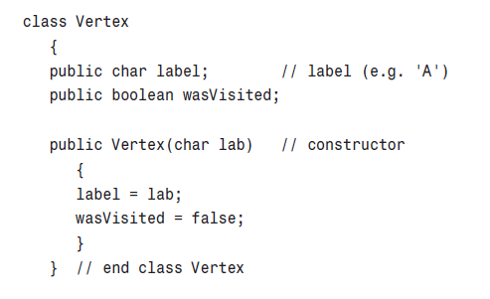
How to represent a Vertex in Java

Slide 17
Fine with Vertices, but how about Edge Representation?
Unlike trees, free-form since any vertex can be connected with any number of other vertices…
Therefore,
Adjacency Matrix
Adjacency Lists
Linked Adjacency Lists
Array Adjacency Lists

Slide 18
Adjacency Matrix
0/1 n x n matrix, where n = # of vertices
A(i,j) = 1 iff (i,j) is an edge
1
2
3
4
5
2
1
0
1
0
1
0
3
2
1
0
0
0
1
1
3
0
0
0
0
1
4
4
1
0
0
0
1
5
5
0
1
1
1
0

Slide 19
Adjacency Matrix Properties
1
2
3
4
5
2
1
0
1
0
1
0
3
2
1
0
0
0
1
1
3
0
0
0
0
1
4
4
1
0
0
0
1
5
5
0
1
1
1
0
Diagonal entries are zero.
Adjacency matrix of an undirected graph is symmetric.
A(i,j) = A(j,i) for all i and j.

Slide 20
Adjacency Matrix (Digraph)
1
2
3
4
5
2
1
0
0
0
1
0
3
2
1
0
0
0
1
1
3
0
0
0
0
0
4
4
0
0
0
0
1
5
5
0
1
1
0
0
Diagonal entries are zero.
Adjacency matrix of a digraph need not be symmetric.

Slide 21
Adjacency Matrix
n² bits of space
For an undirected graph, may store only lower or upper triangle (exclude diagonal).
(n-1)n/2 bits
O(n) time to find vertex degree and/or vertices adjacent to a given vertex.

Slide 22
Adjacency Lists
Adjacency list for vertex i is a linear list of vertices adjacent from vertex i.
An array of n adjacency lists.
aList[1] = (2,4)
aList[2] = (1,5)
aList[3] = (5)
aList[4] = (5,1)
aList[5] = (2,4,3)
2
3
1
4
5

Slide 23
Linked Adjacency Lists
Each adjacency list is a chain.
2
aList[1]
2
4
3
[2]
1
5
1
[3]
5
[4]
5
1
4
aList[5]
2
4
3
5
Array Length = n
e.g., # of chain nodes = 2e (undirected graph)
e.g., # of chain nodes = e (digraph)

Slide 24
Array Adjacency Lists
Each adjacency list is an array list.
2
aList[1]
2
4
3
[2]
1
5
1
[3]
5
[4]
5
1
4
aList[5]
2
4
3
5
Array Length = n
# of list elements = 2e (undirected graph)
# of list elements = e (digraph)

Slide 25
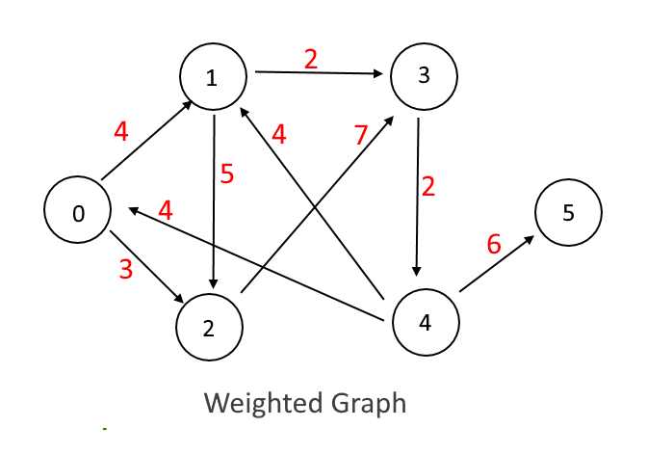
Challenge for the class: How would you represent this weighted graph?

